Slide 1

aug 2024
mickey debttracker
XUANYI ZHOU
Never Cougent the Wrong Company

Slide 2
Scene Cut
Tom and his classmates went to a restaurant to eat. The five of them spent a total of $100 on the meal. How much should each person pay?

Slide 3
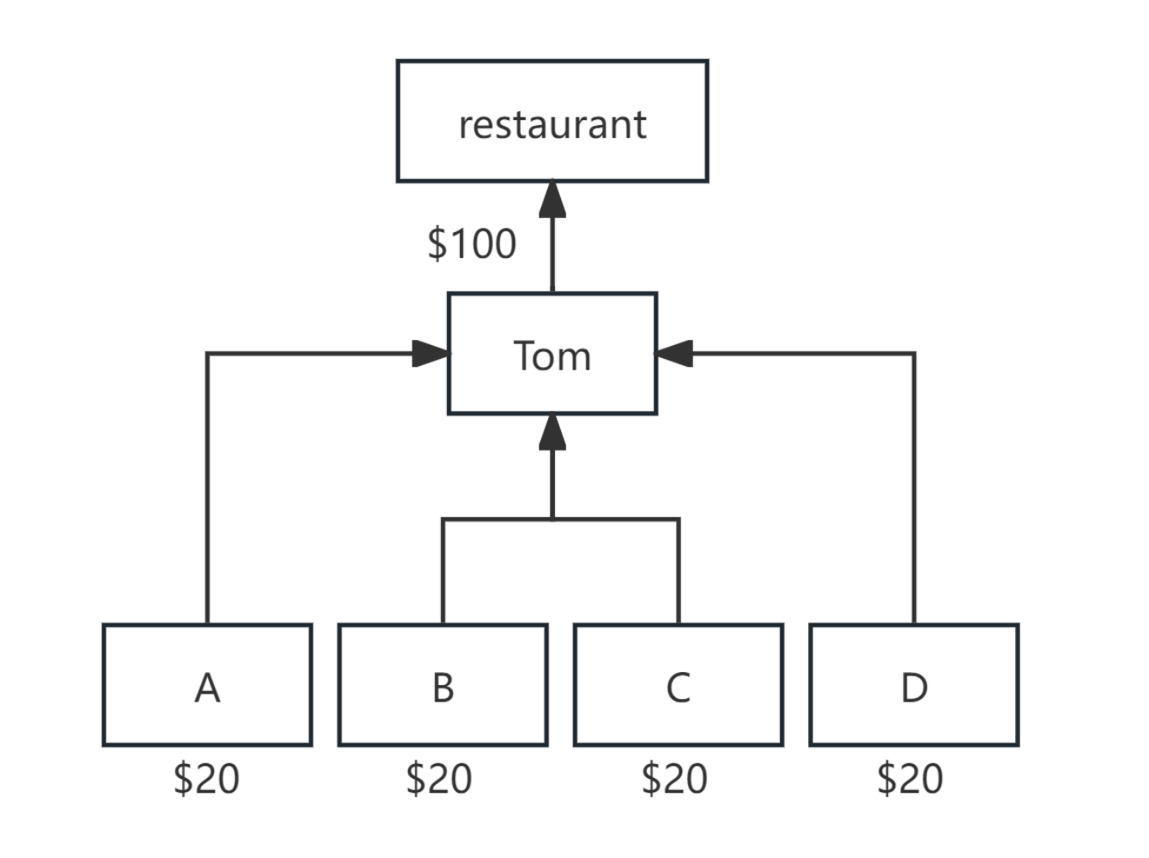

Slide 4
The five of them spent a total of $100 on food, but each person ate differently.
A and B only ate $30 of it
B, C, and D ate $60 together
D and Tom ate the remaining $10.
How much should each person pay?

Slide 5
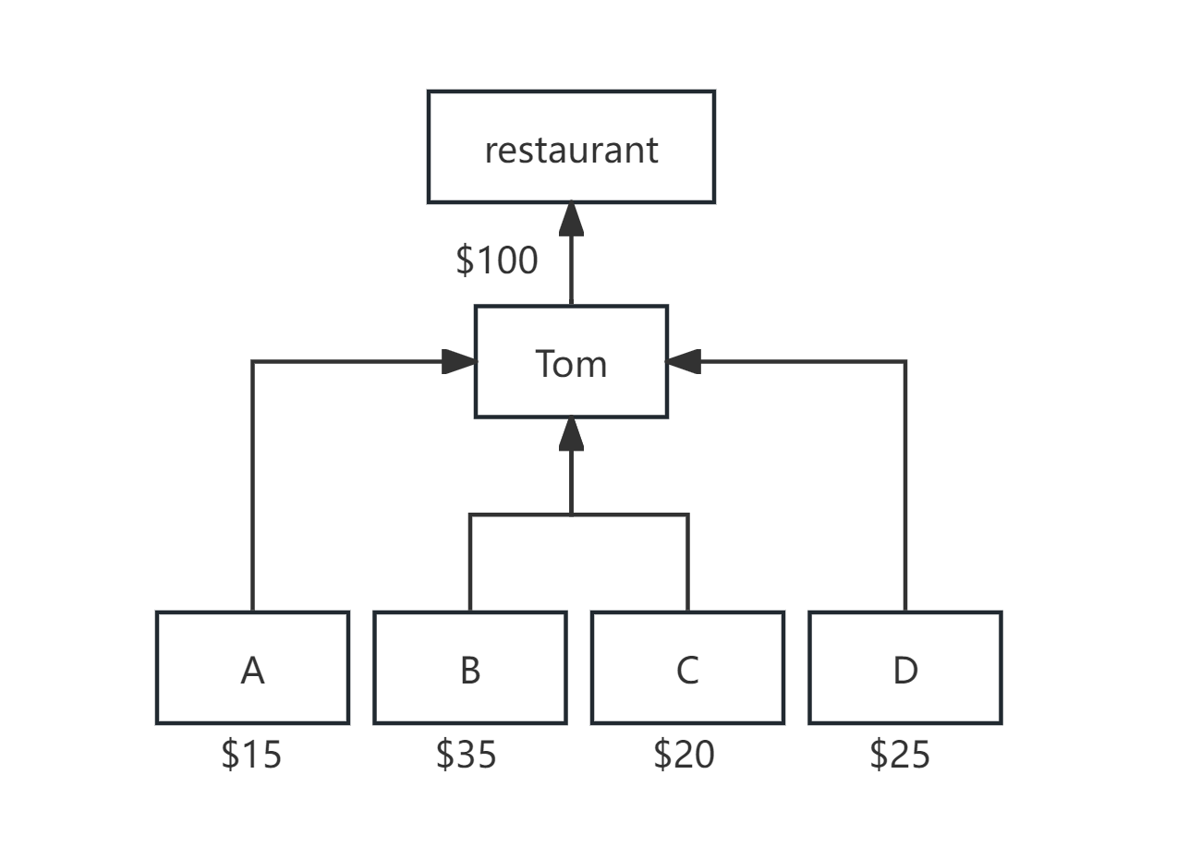

Slide 6
AUG 2024
Problems that
our program hopes to solve
JIAHAO WANG

Slide 7
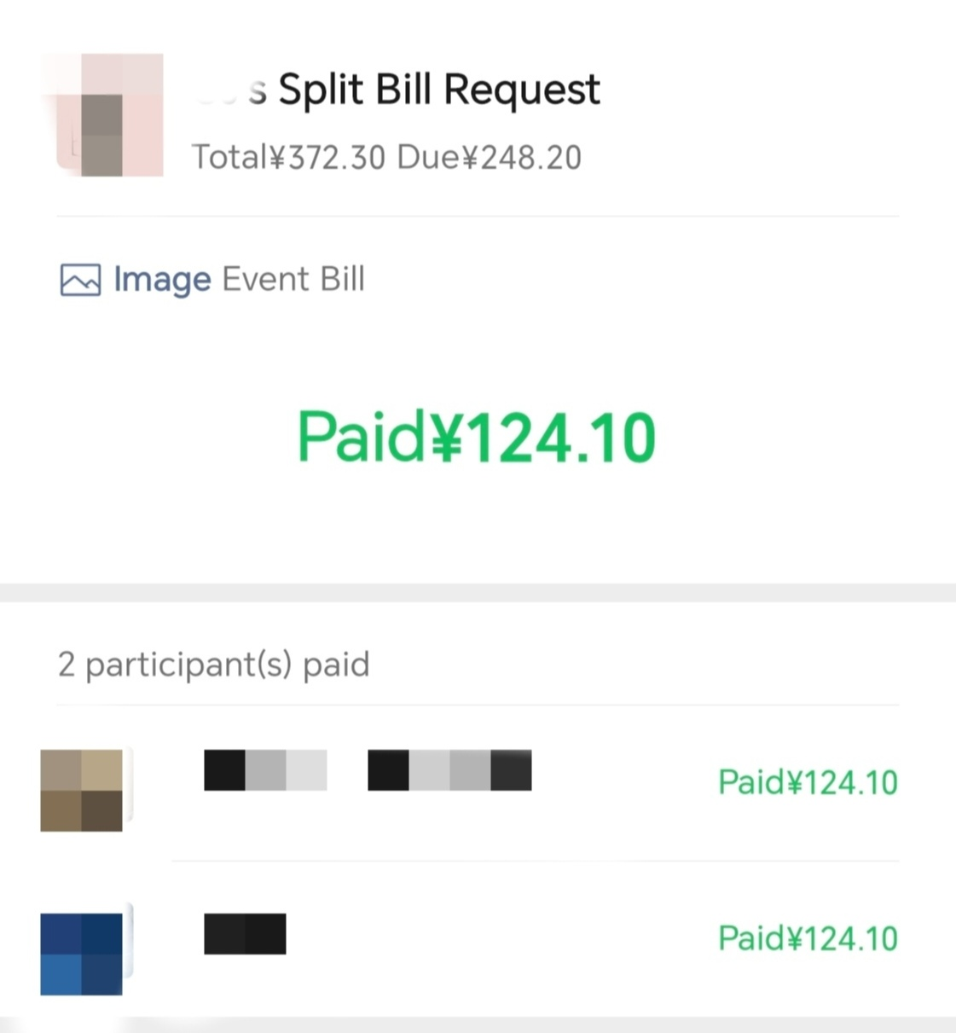
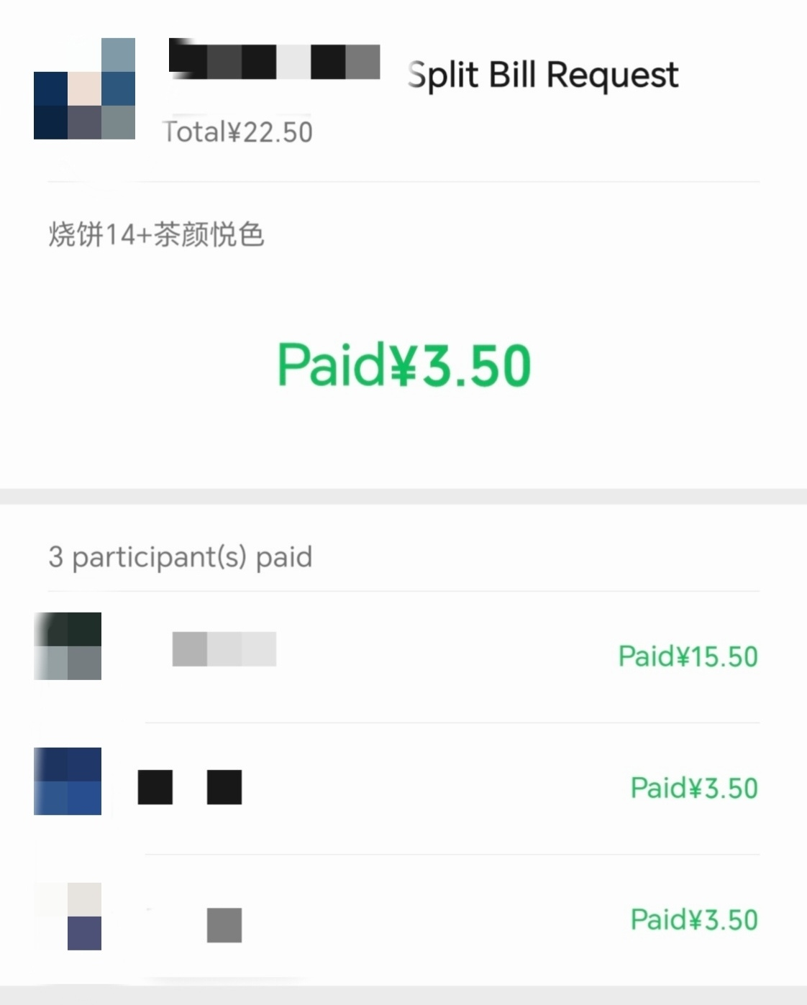
When calculating how much money everyone should pay for creditors, there are already solutions, but they are not accurate and efficient.
Figure 1. A Wechat equal split example
Figure 2. A Wechat custom split example.

Slide 8
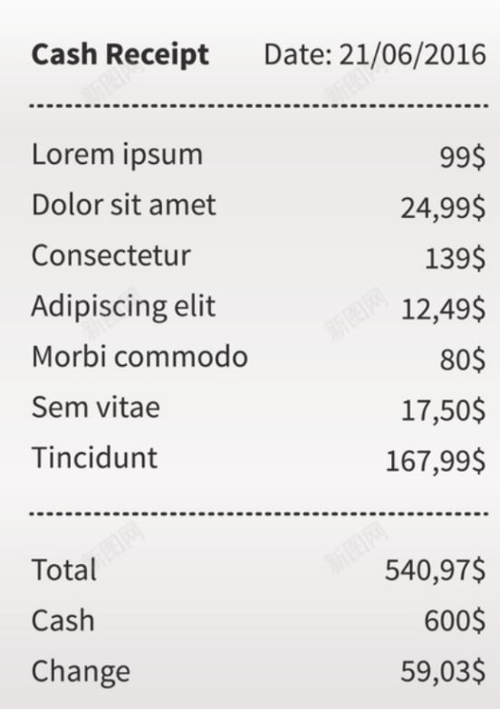
2. Debt Relationships and payment information are easy to lose.
Can you save it well?
Figure 3. A receipt.
https://www.bing.com/images/search?view=detailV2&ccid=Yl7sP3g2&id=033C0AF847B6A2F5D4C70F638926229A45E3FDF7&thid=OIP.Yl7sP3g2-WX_kXmHFfB7MQHaJo&mediaurl=https%3a%2f%2fimg.ixintu.com%2fdownload%2fjpg%2f201912%2f30cbb0866807580aaa16ac3bc306884b.jpg!con&cdnurl=https%3a%2f%2fth.bing.com%2fth%2fid%2fR.625eec3f7836f965ff91798715f07b31%3frik%3d9%252f3jRZoiJoljDw%26pid%3dImgRaw%26r%3d0&exph=794&expw=610&q=%e5%b0%8f%e7%a5%a8%e5%9b%be%e7%89%87&simid=608031945324102846&FORM=IRPRST&ck=559D86E589A90D088986B0F2D887CFC4&selectedIndex=4&itb=0

Slide 9
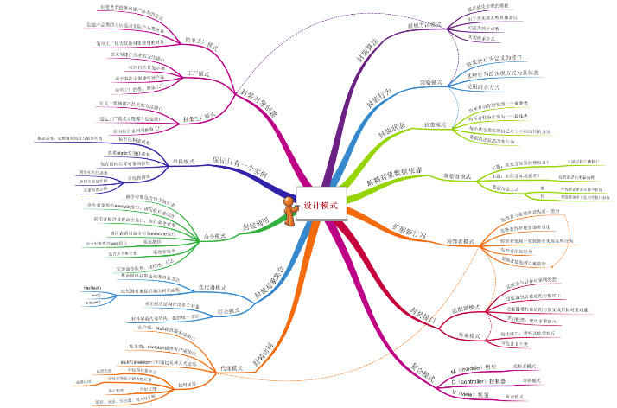
3. In some complex cases, we want to see the relationship between debts and debts more clearly.
Figure 4. A thinking map.
https://th.bing.com/th/id/R.eecd9eb81048bc2ec7f881bdeafb7f83?rik=mkyadl6OBMY4dw&riu=http%3a%2f%2fimages.cnitblog.com%2fblog%2f448646%2f201310%2f02162323-a8ea2a2f09c84eabbc151e9965dc7c69.png&ehk=T8bhNXlQ6OOdxrnHSGlqvebELa8rdC%2fA1Oa%2f1yu9PMY%3d&risl=&pid=ImgRaw&r=0

Slide 10
AUG 2024
Program Function Introduction
Yingcheng Zhang

Slide 11
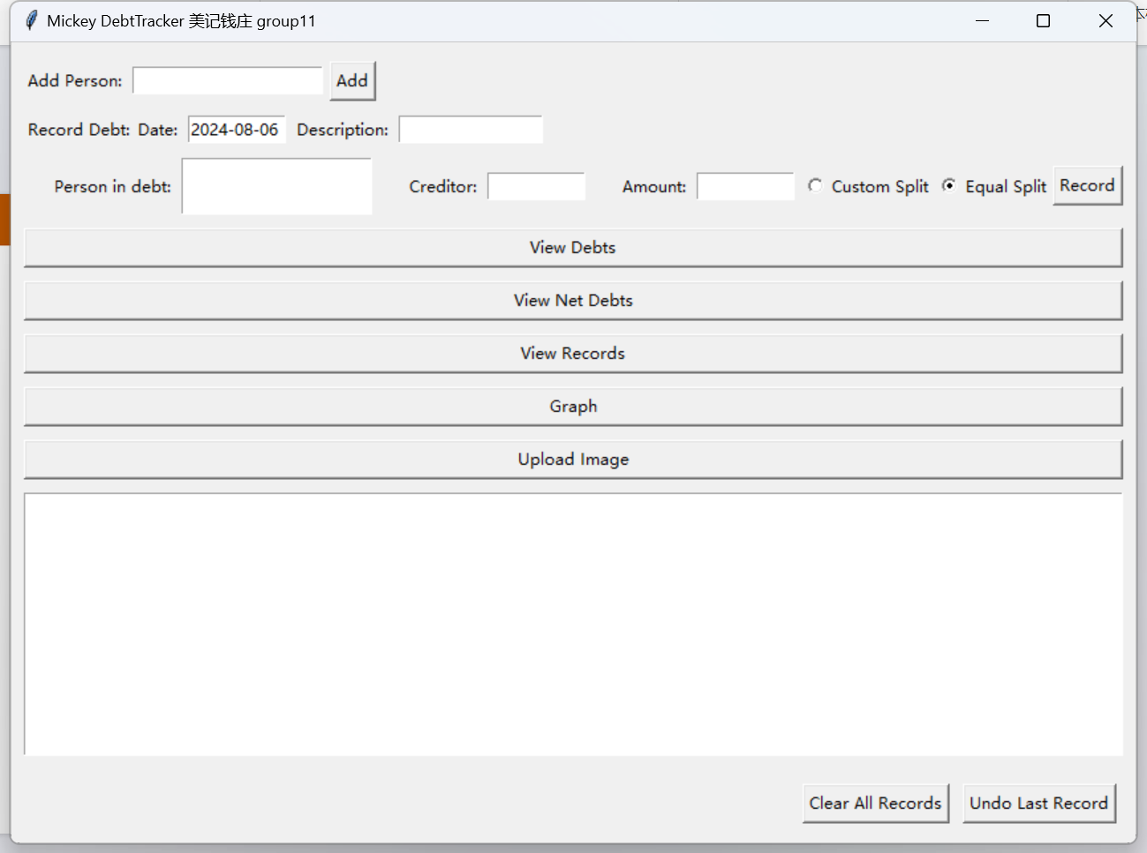

Slide 12
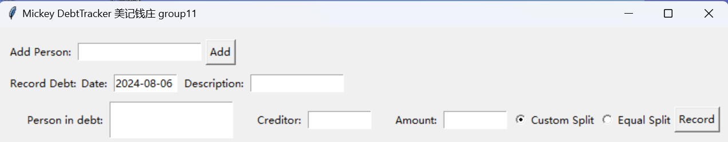
For users to add person
main window
some description
add the person in debt
import the total money users need to pay
add the creditor

Slide 13
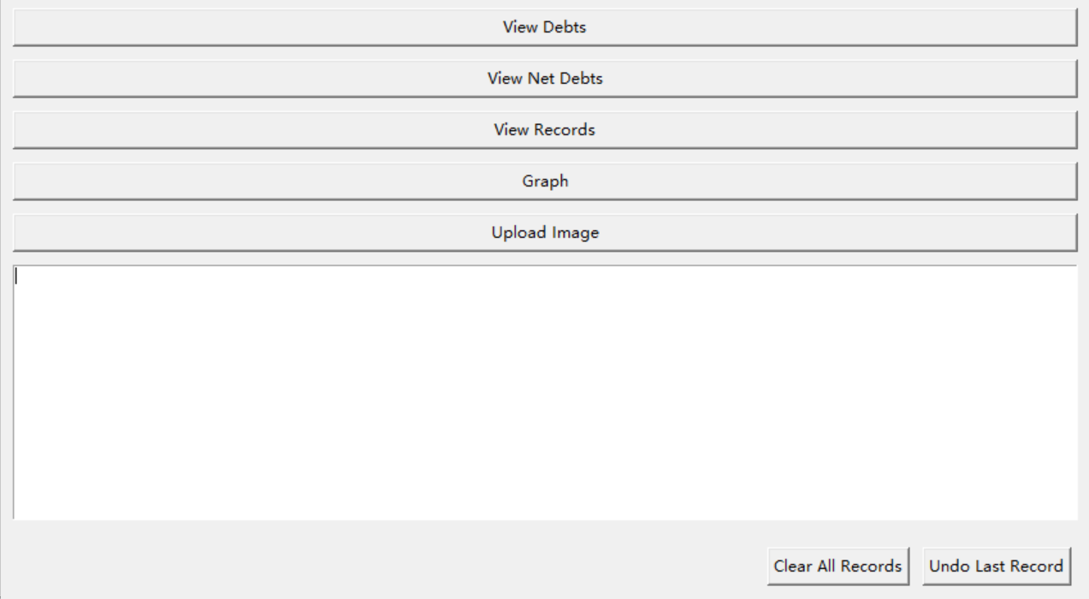
sb. owns sb. $
sb. owns $
more detailed
show the relaitionship graph
Download locally

Slide 14
AUG 2024
Features
Wen Zheng

Slide 15
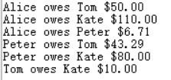
Say Goodbye to Calculations!

Slide 16
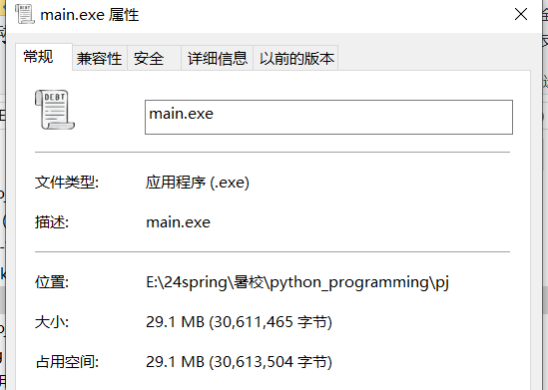
Ready-to-Run .EXE!

Slide 17
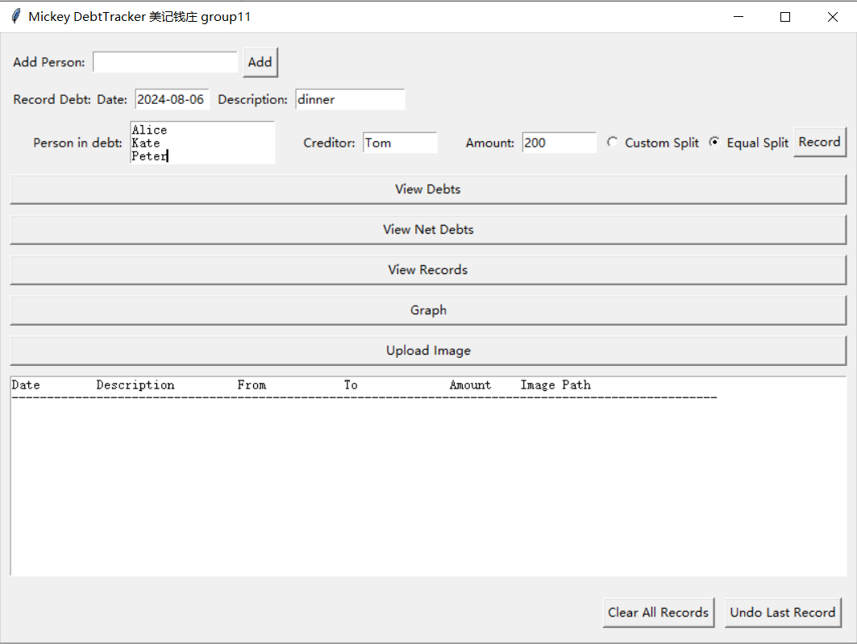
No Tech Skills Required!

Slide 18
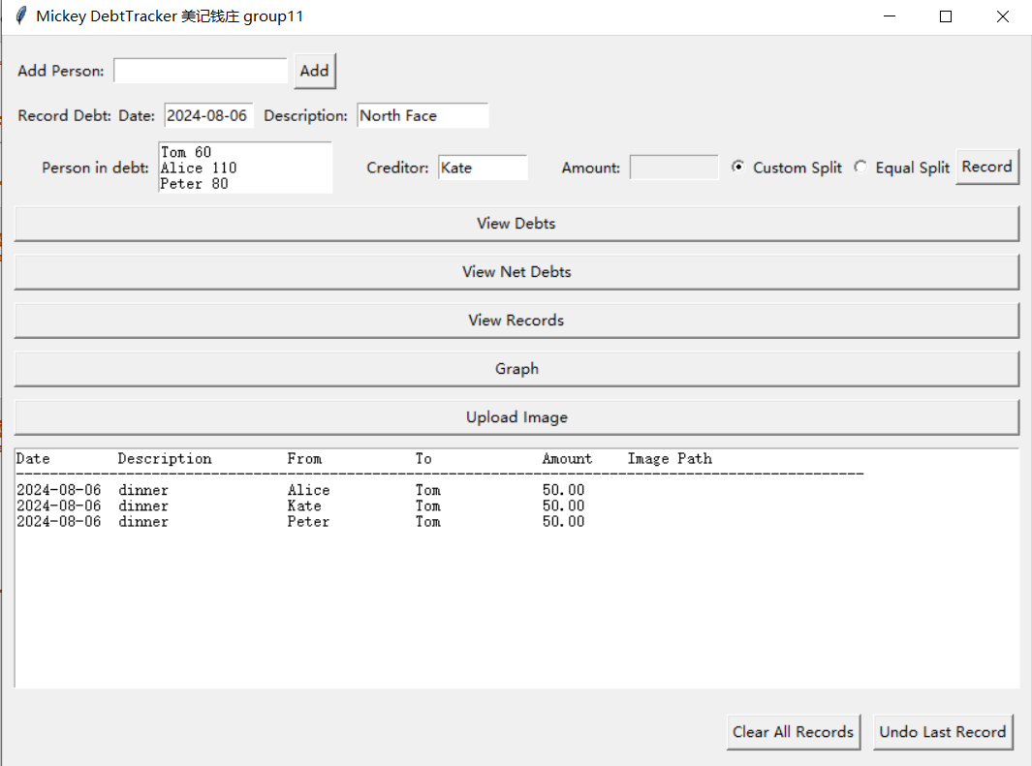
No Tech Skills Required!
name debt

Slide 19
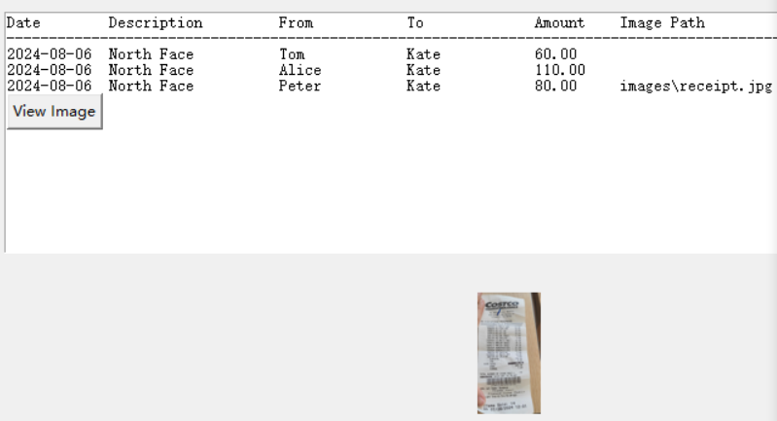
Add Your Receipts!

Slide 20
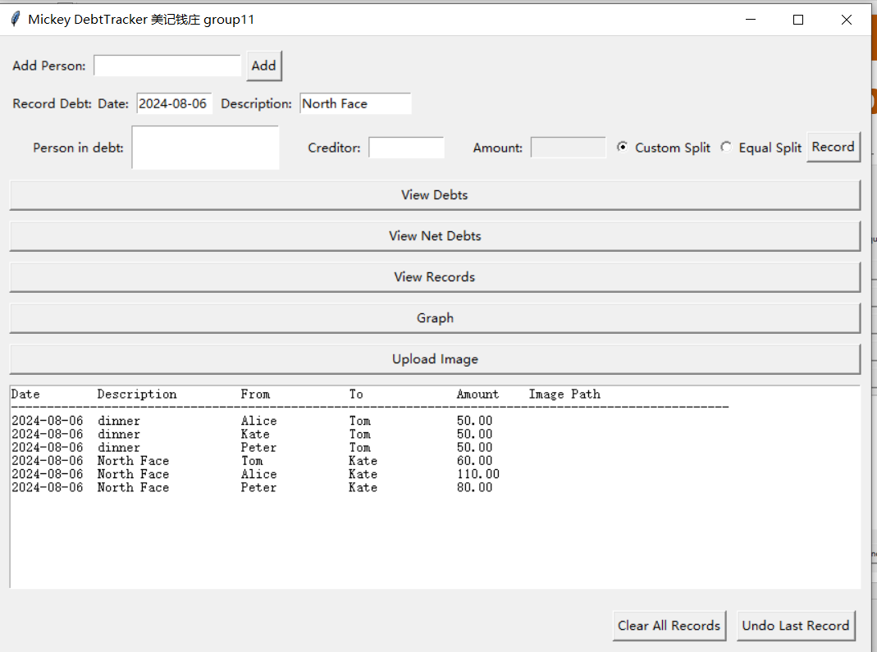
Flexible Debt Views!

Slide 21
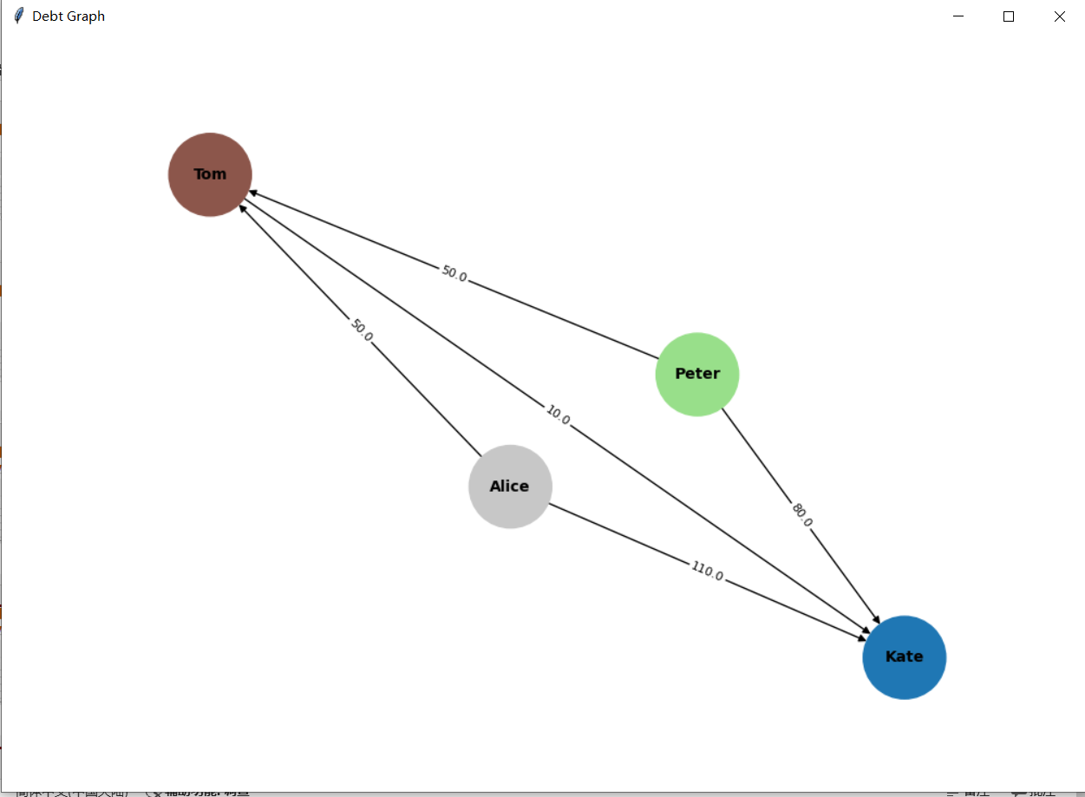
Flexible Debt Views!

Slide 22
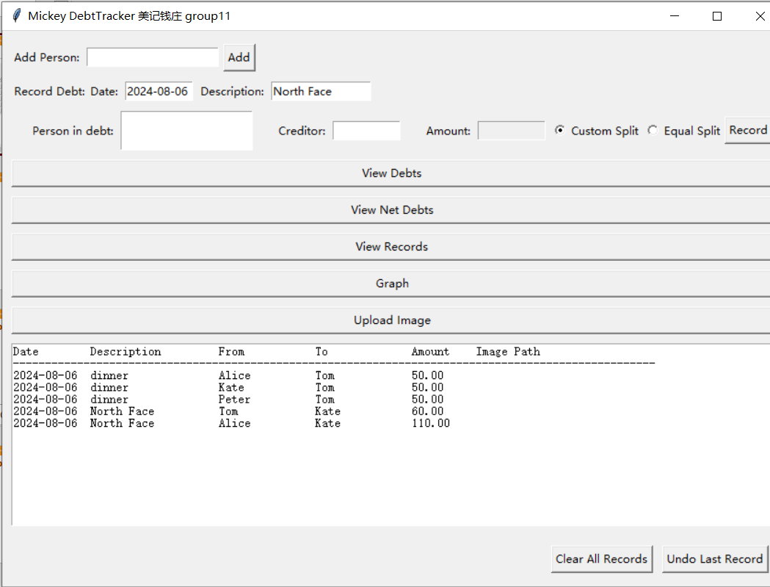
One-Click Fixes!

Slide 23
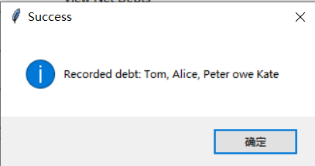
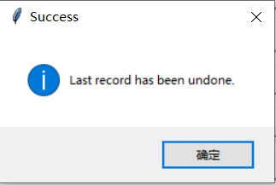
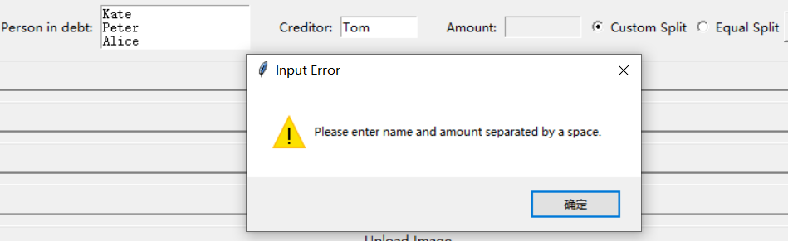

Timely pop-up messages!

Slide 24
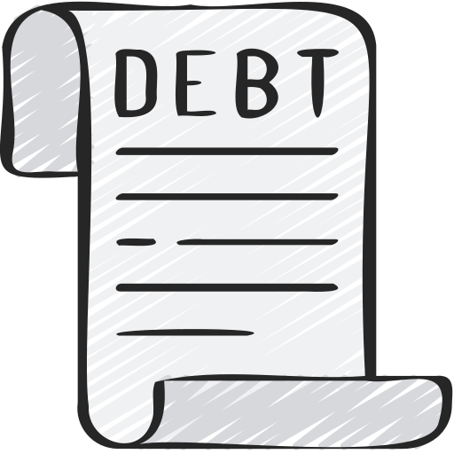
Practical Demonstration Section

Slide 25
Price & Services
Scenario: Travel and Group Expenses
Continuous tracking of multiple transactions among a group
Calculate net debt relationships and settle all debts in one go using a graph

Slide 26
Use Cases: Meal Splitting
Equal Split
Five people spend $100 on a meal
Payment is evenly split among all participants
Custom Split
A and B spend $30 together
B, C, and D spend $60 together
D and E spend $10 together
Each person pays for their part

Slide 27
Services Provided:
Accurate and Efficient Debt Tracking
Visual Debt Relationships
Secure Debt and Payment Information
User-Friendly Interface
Practical Demonstrations and Timely Notifications

Slide 28
Service Tiers
Basic
Essential features for small groups
Premium
Advanced features and larger group support
Enterprise
Custom solutions for businesses and large organizations

Slide 29
Thank you !
Gracias!

